Slide 1
TWEESENT Sentiment Analysis of COVID-19 Tweets – Visualization Dashboard (DATA PREPROCESSING)
By:
Name Terror
(Roshnee Matlani)

Slide 2
DATA PREPROCESSING
Data preprocessing involves the transformation of the raw dataset into an understandable format. Preprocessing data is a fundamental stage in data mining to improve data efficiency. The data preprocessing methods directly affect the outcomes of any analytic algorithm.
Data cleansing or data cleaning is the process of detecting and correcting (or removing) corrupt or inaccurate records from a record set, table, or database and refers to identifying incomplete, incorrect, inaccurate or irrelevant parts of the data and then replacing, modifying, or deleting the dirty or coarse data.

Slide 3
DATA PREPROCESSING
Removing the first line: it contains extraneous text instead of the column titles. This text prevents the data set from being parsed properly by the pandas library.
Removing columns with text explanations that we won’t need, url columns and other unnecessary columns.
To fill the missing values in data:
There are several ways to fill up missing values:
you can remove the lines with the data if you have your data set is big enough and the percentage of missing values is high (over 50%, for example);
you can fill all null variables with 0 is dealing with numerical values;
you can use the Imputerclass from the scikit-learn library to fill in missing values with the data’s (mean, median, most_frequent)
you can also decide to fill up missing values with whatever value comes directly after it in the same column.

Slide 4
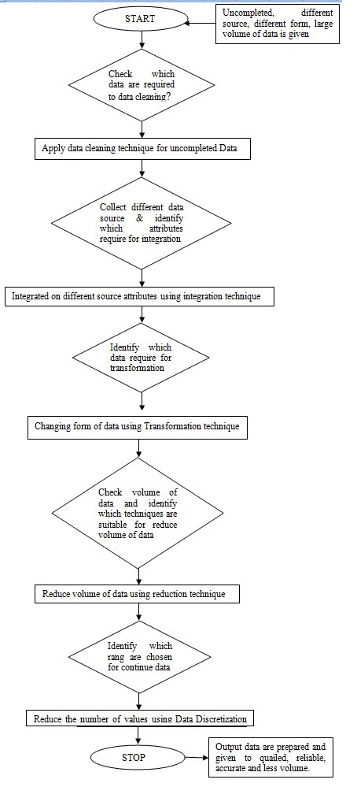
FLOW CHART FOR DATA PREPROCESSING

